Slide 1
Plants in a Suitcase
How to package your plants for air travel and how to bring them into this country

Slide 2
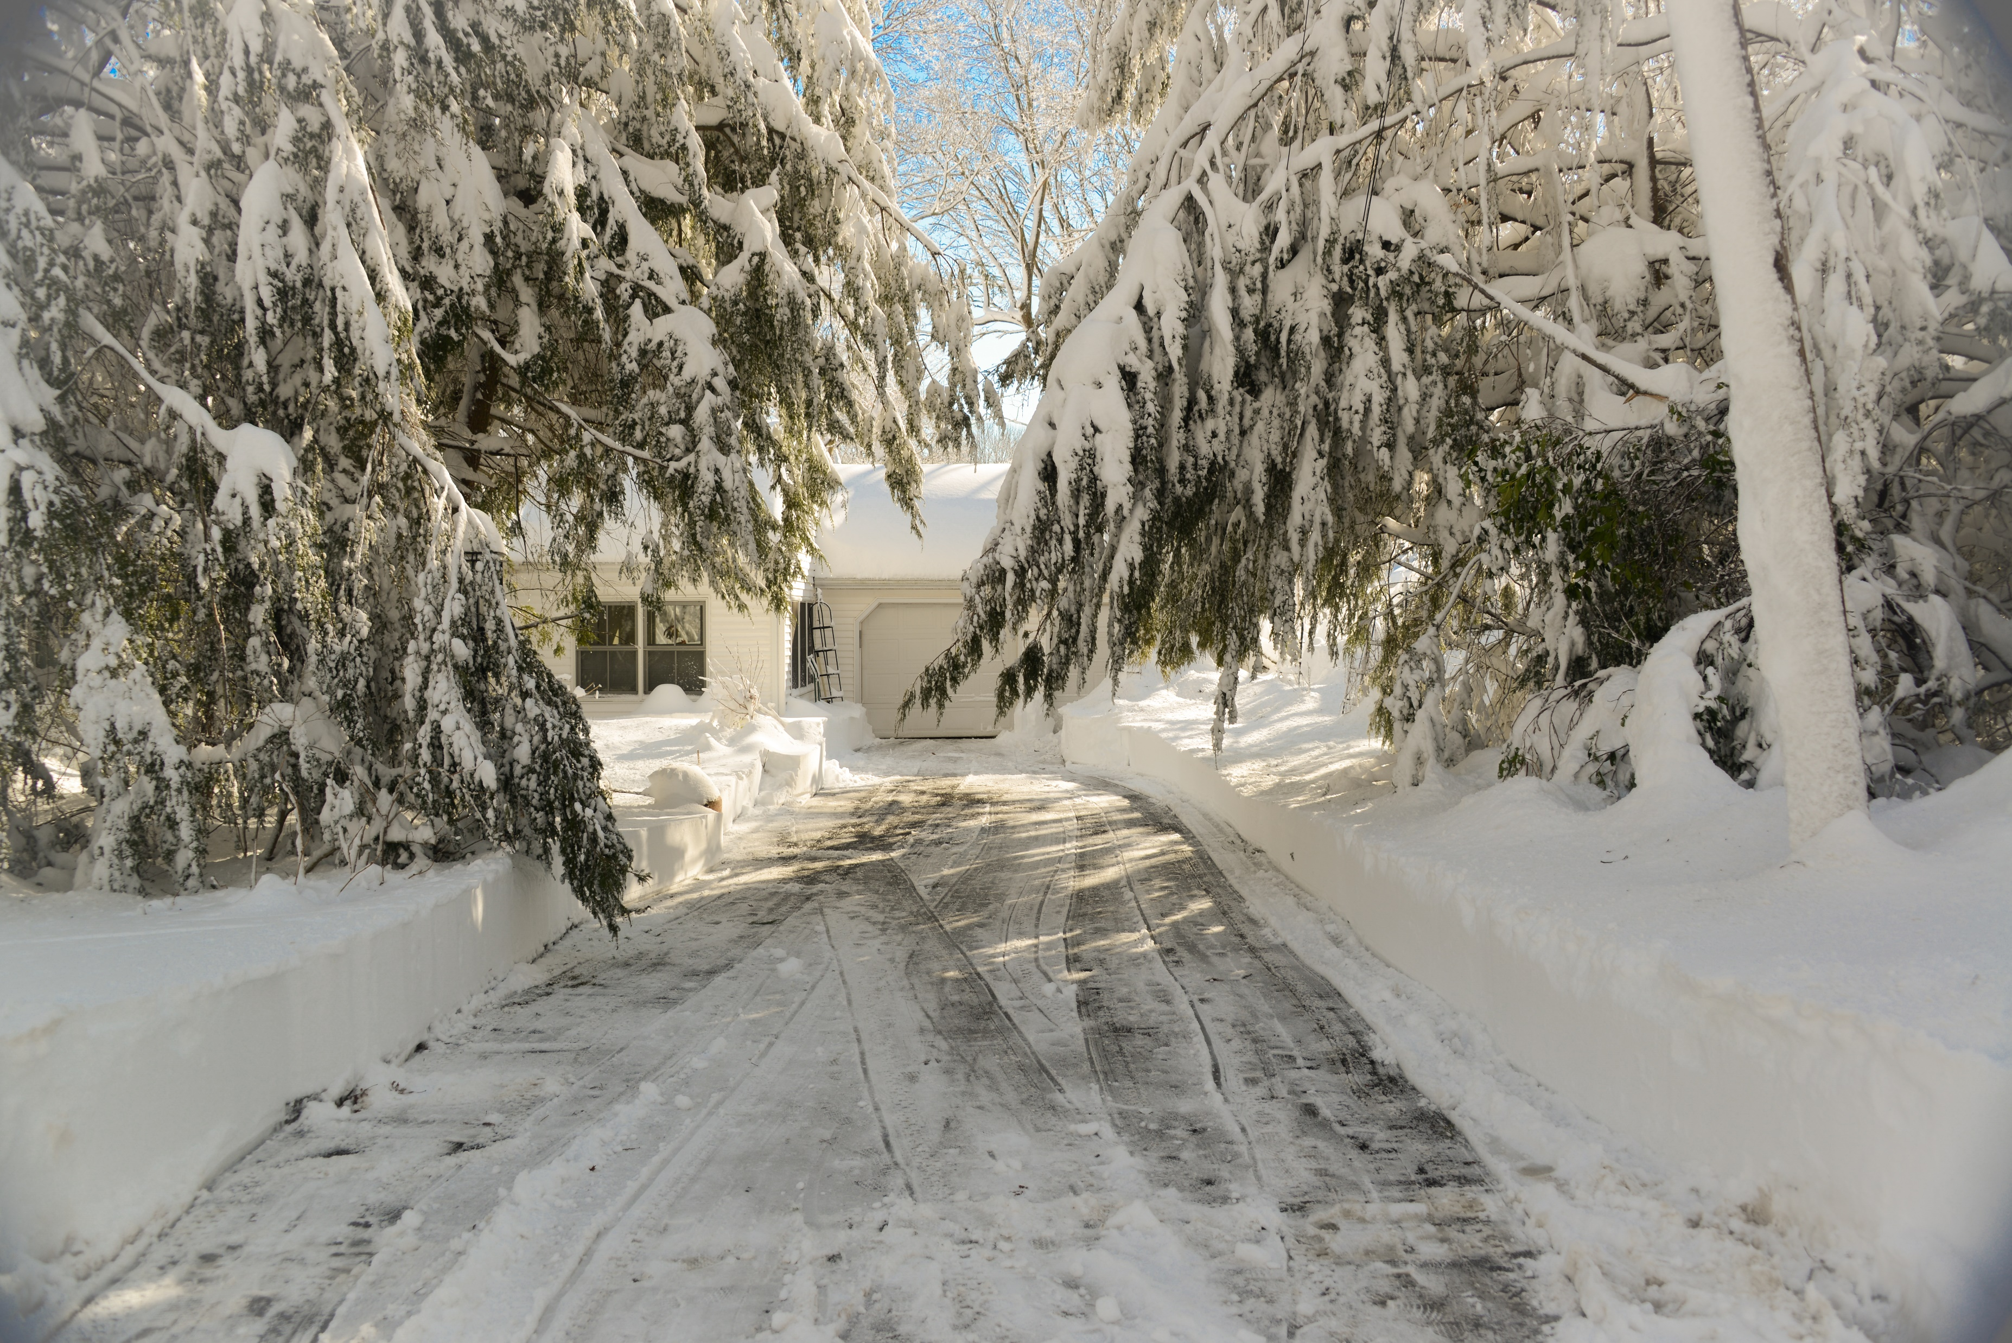

Slide 3
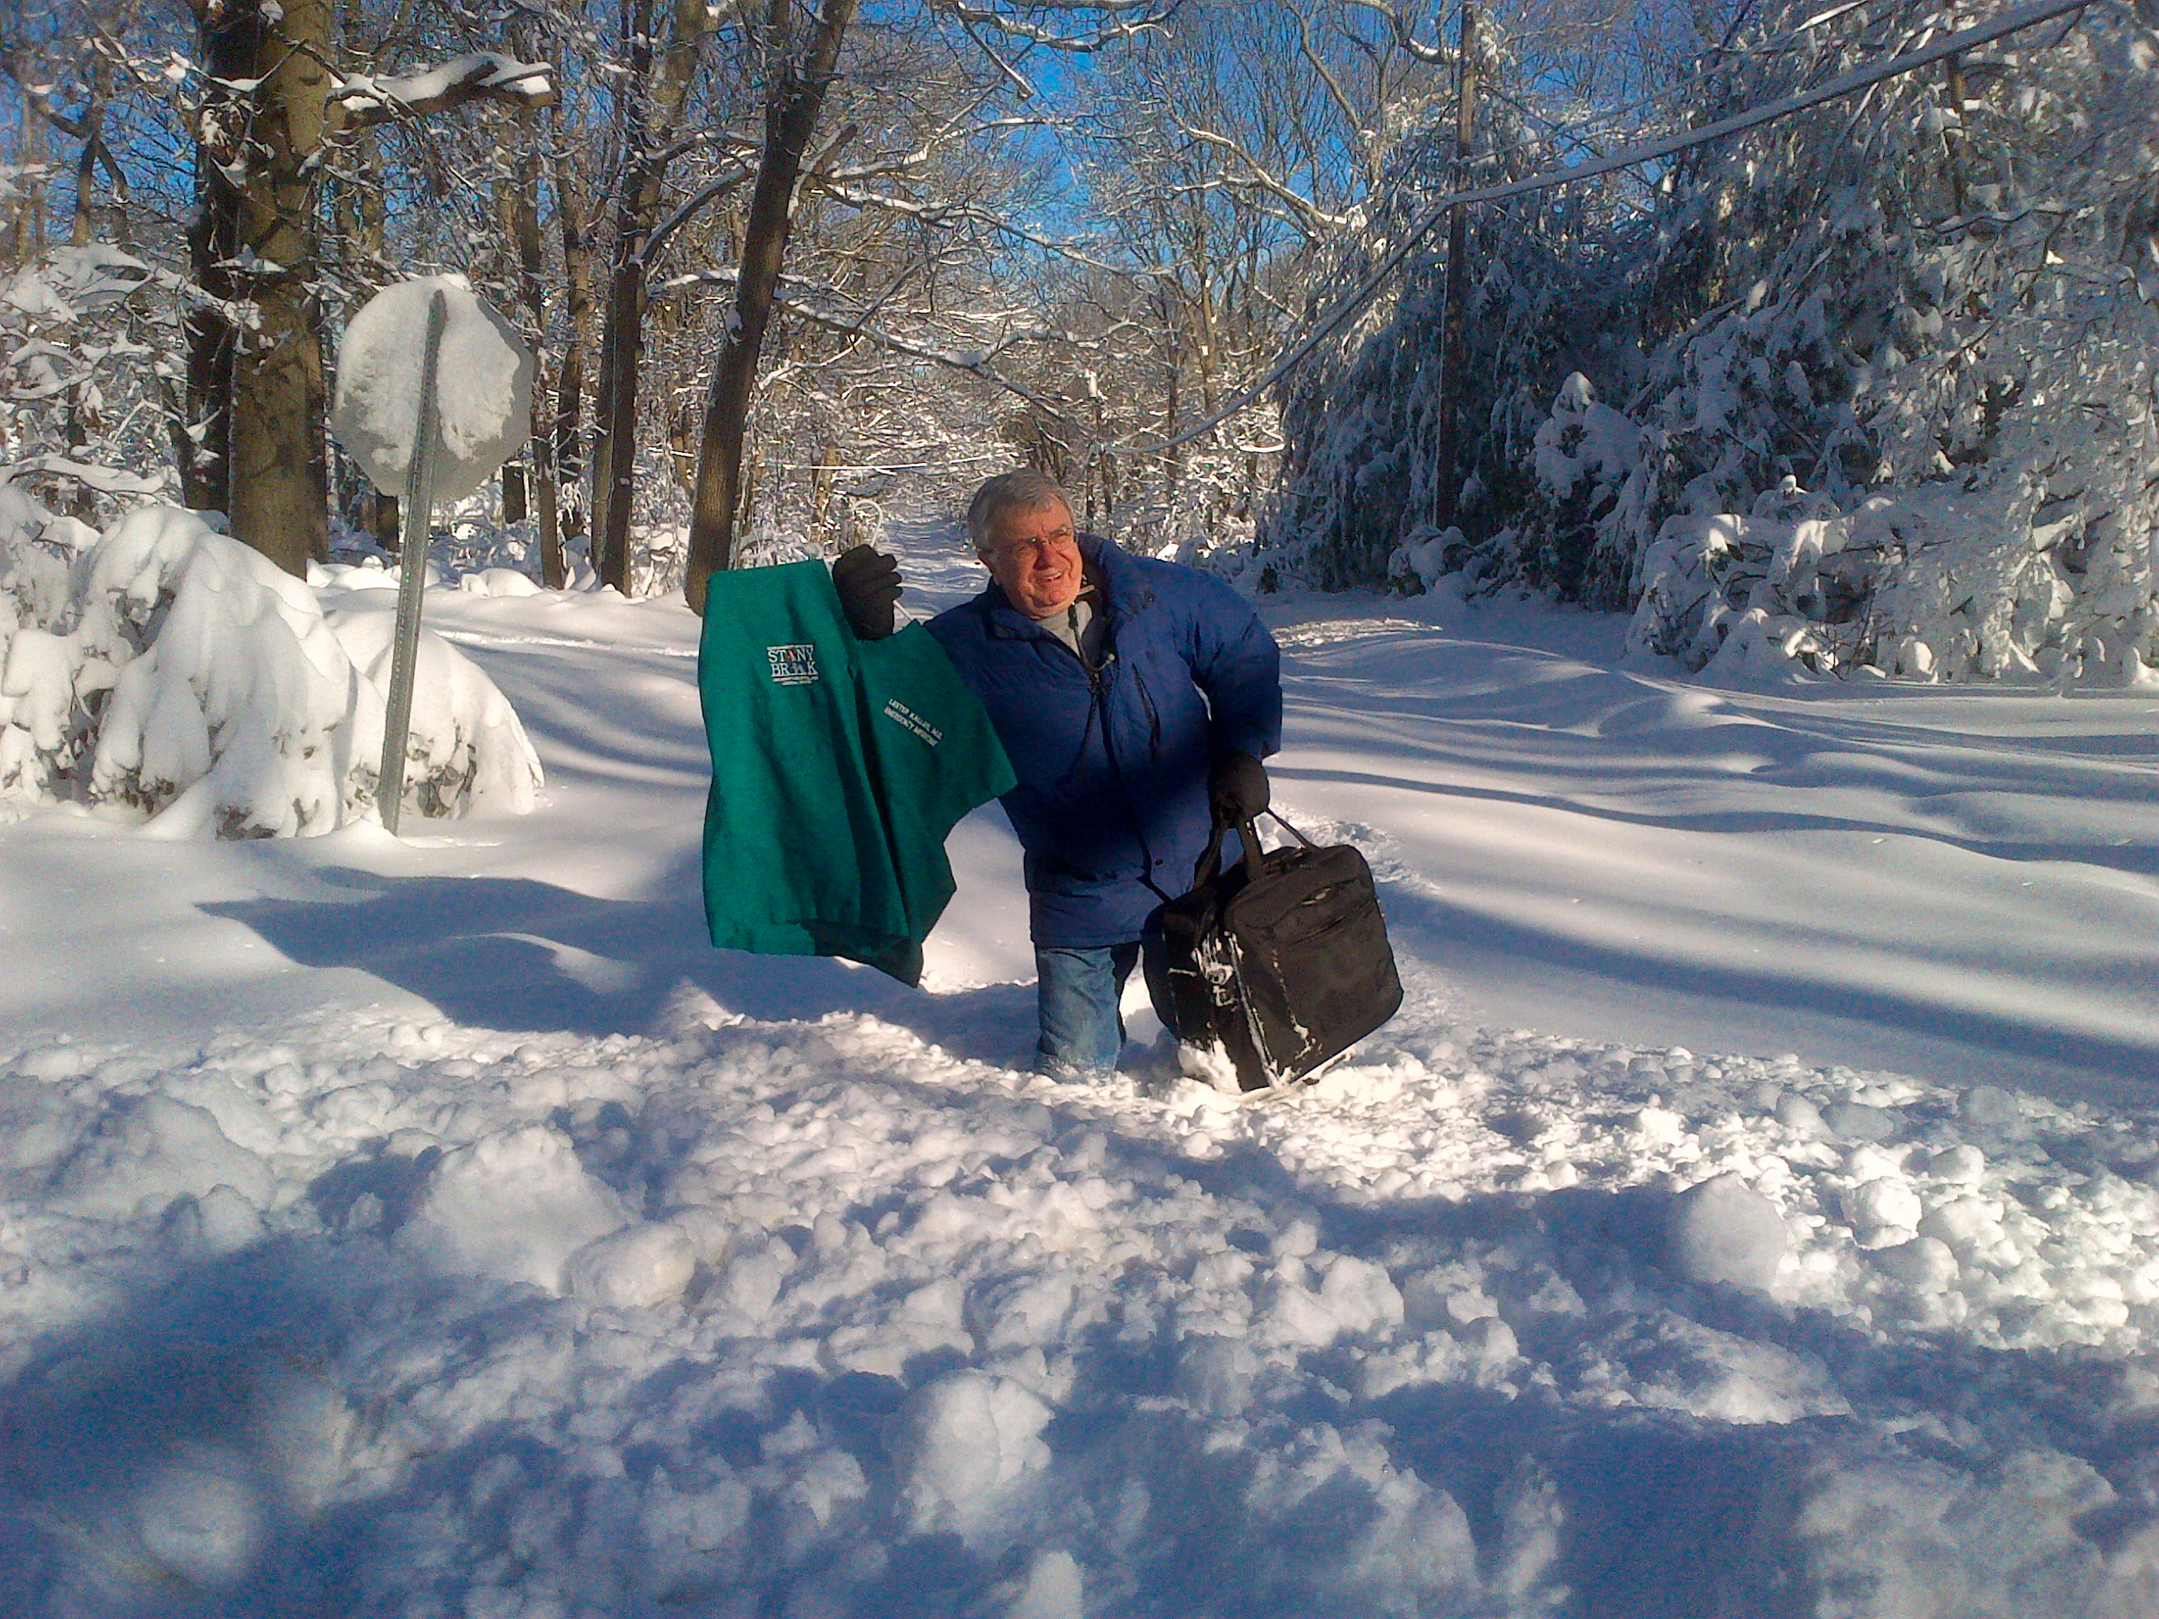

Slide 4
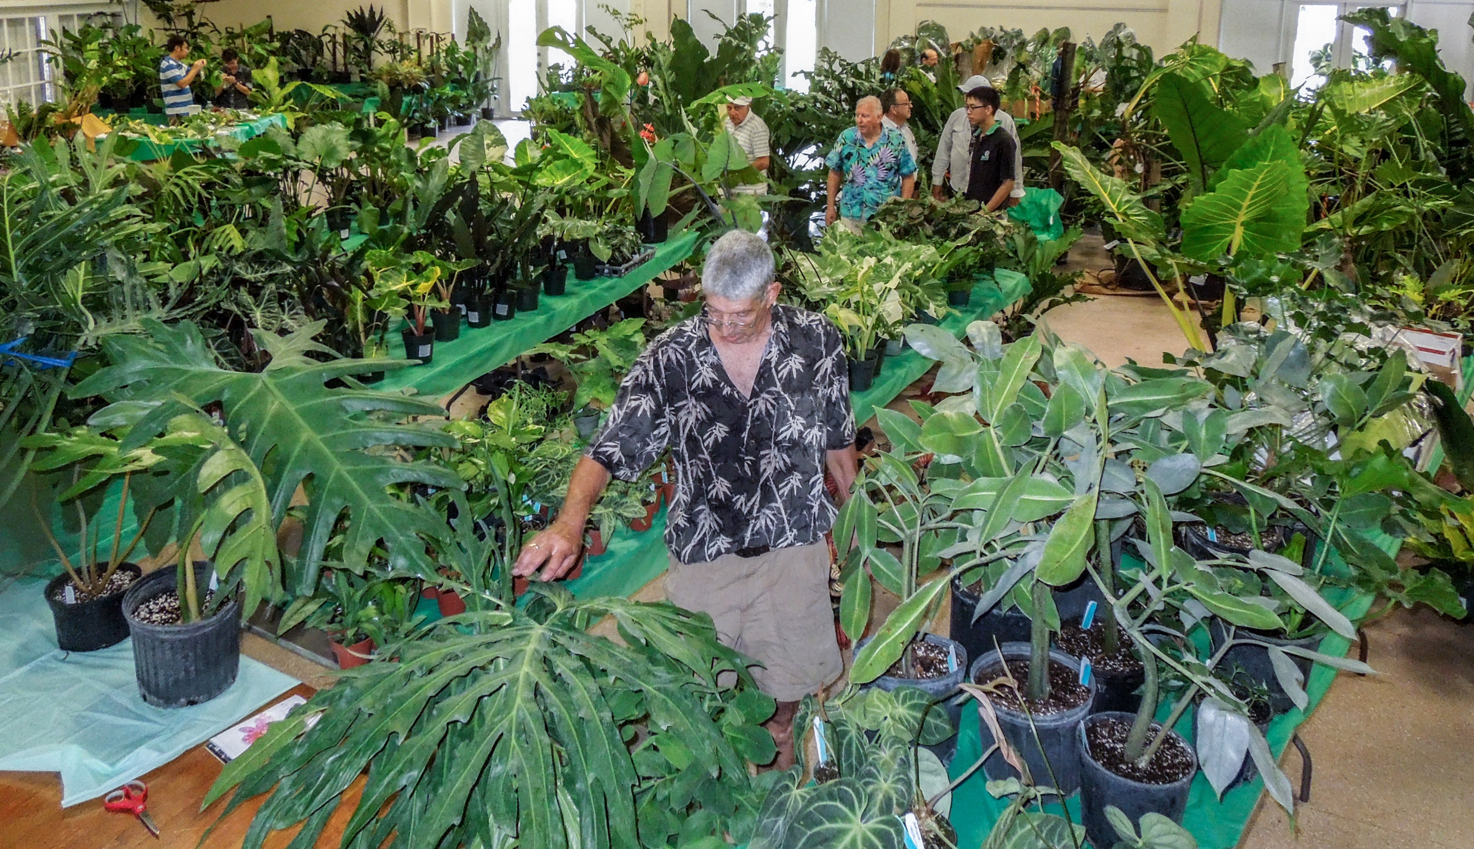

Slide 6
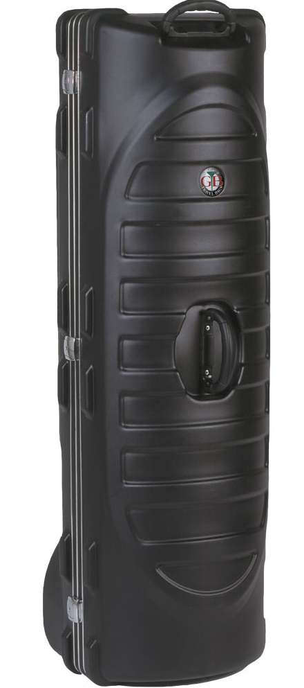
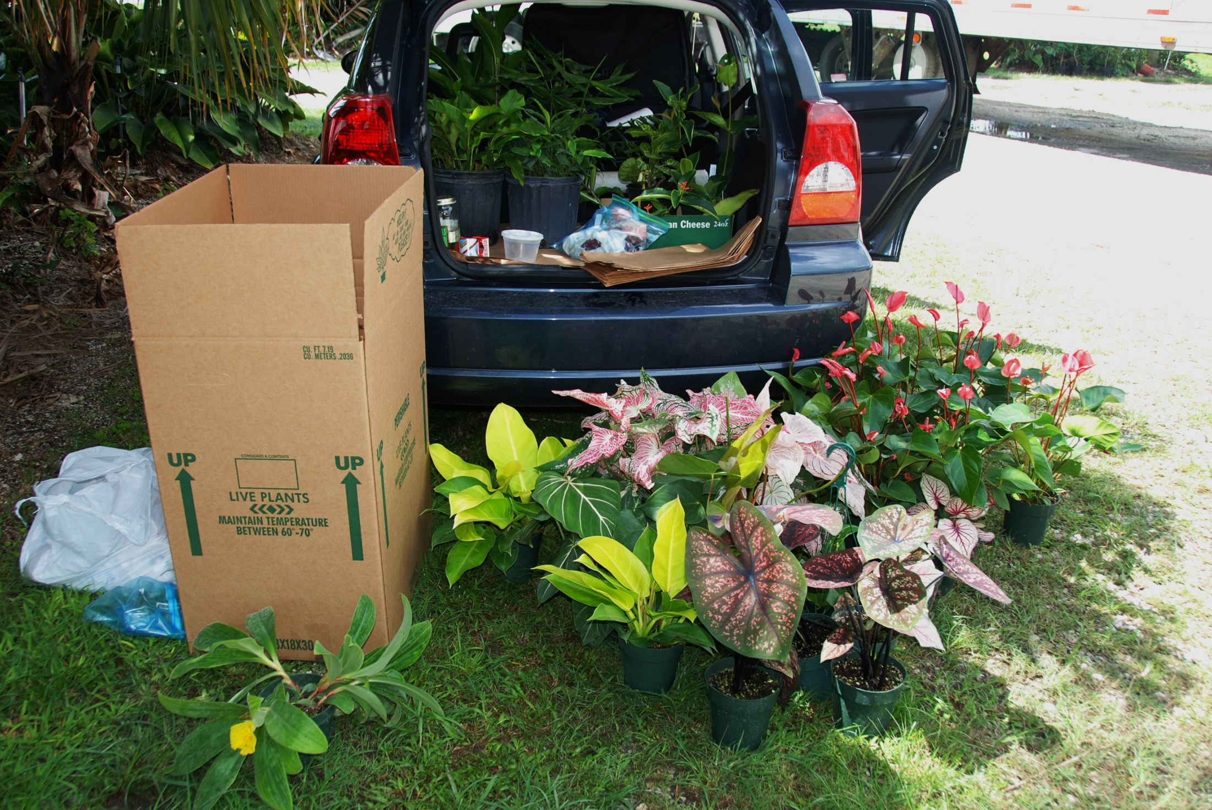
Here’s what I wanted to take home in a suitcase or a box
It doesn’t matter – the question is, how to get it home safely?

Slide 7
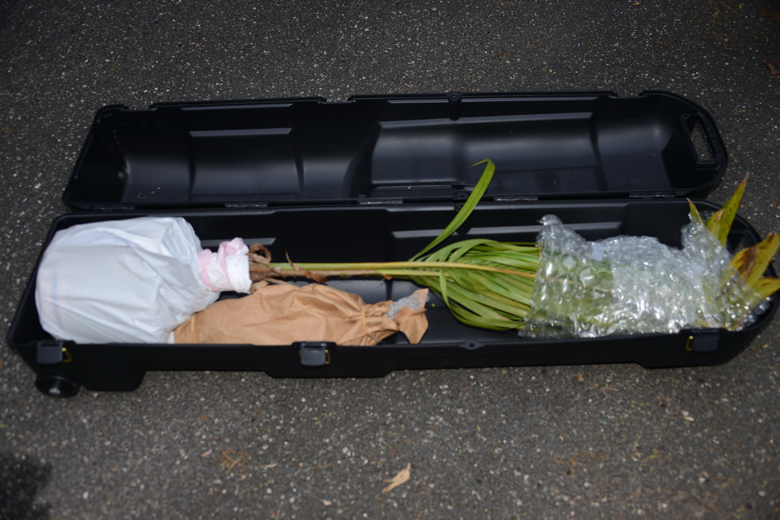

Slide 8
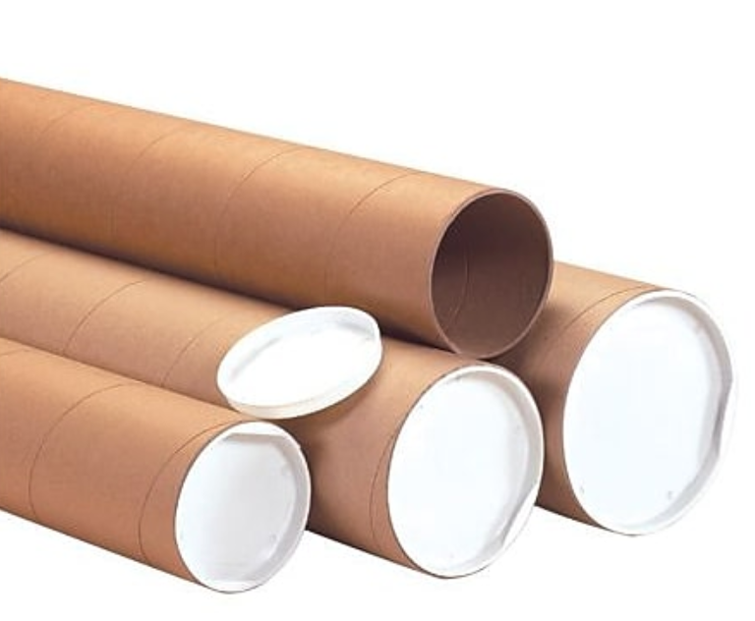
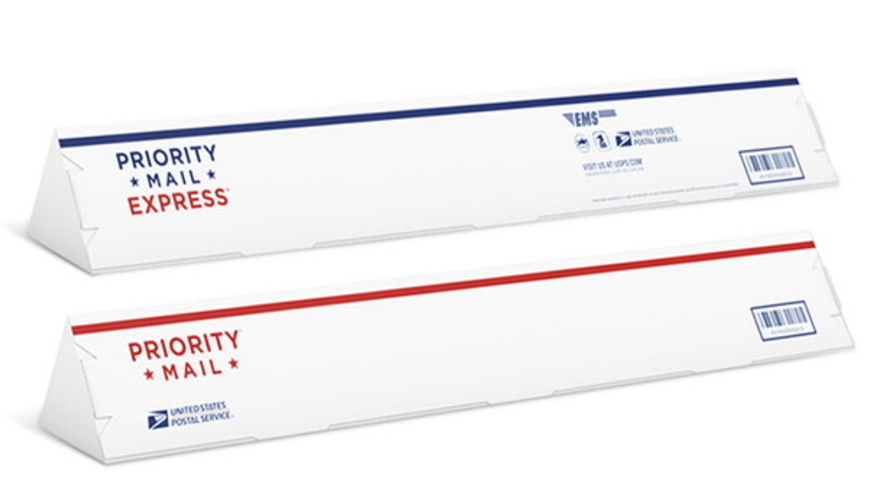
Mailing Tubes
Staples Office Depot
USPS

Slide 9
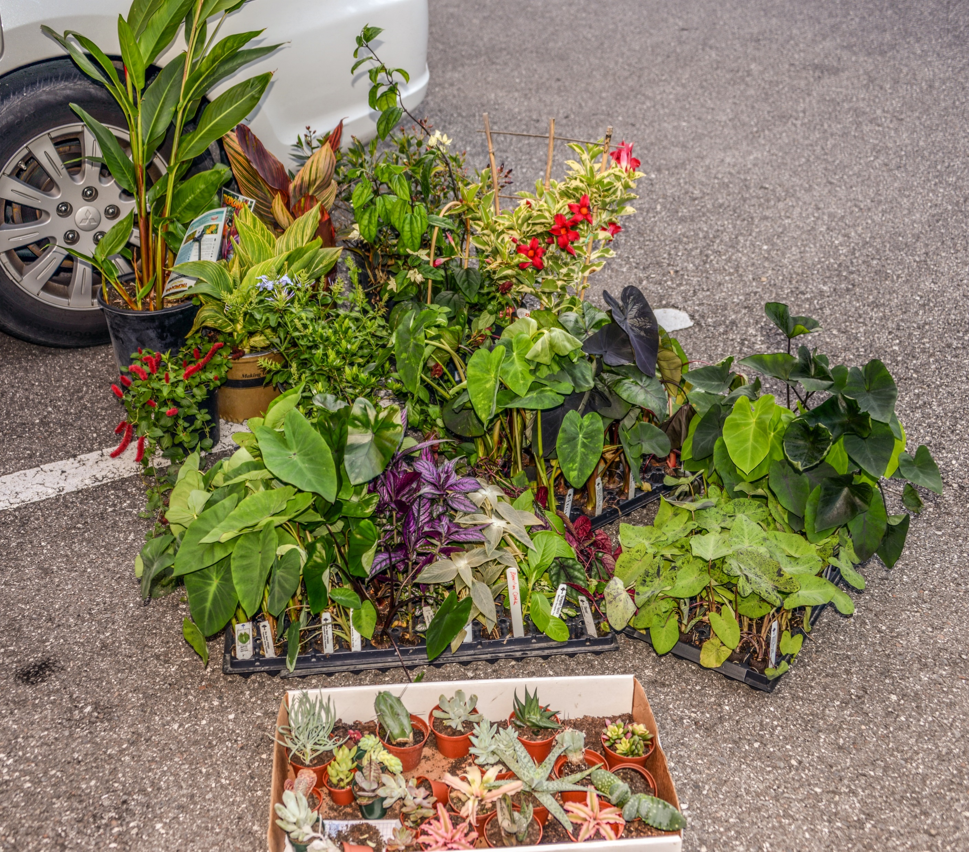
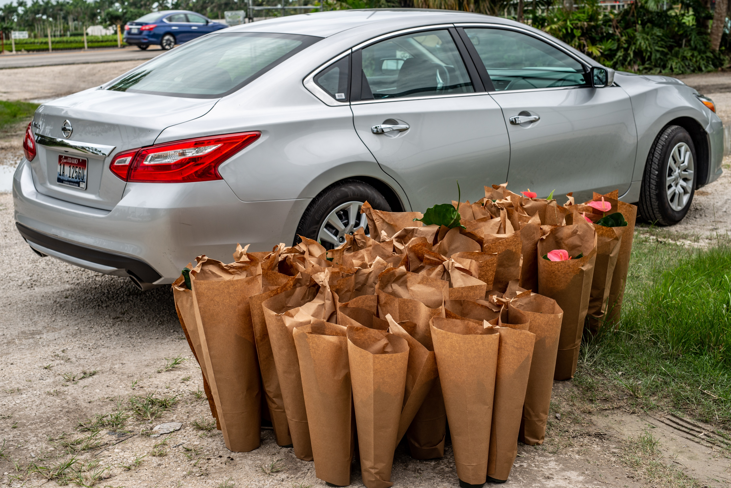
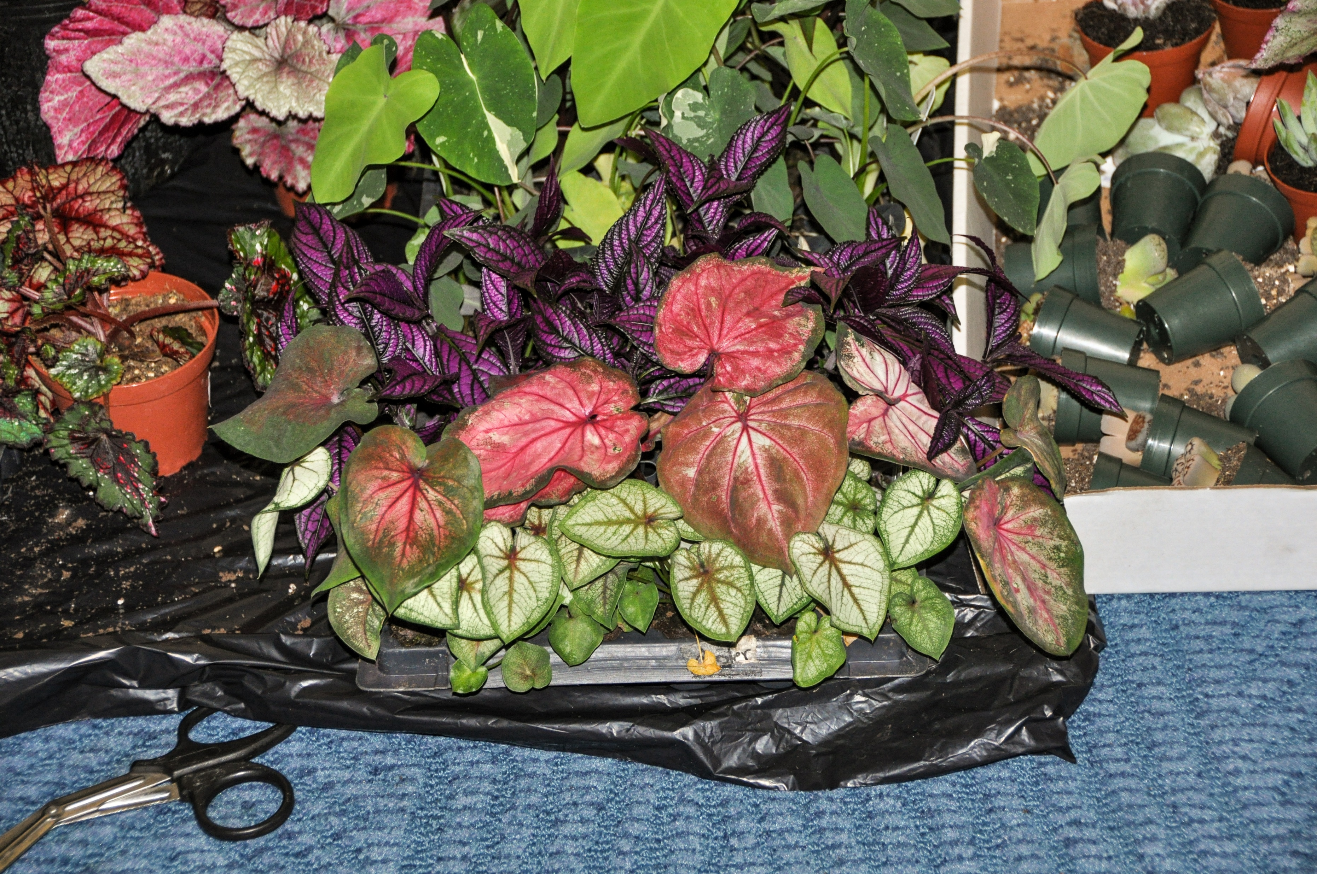
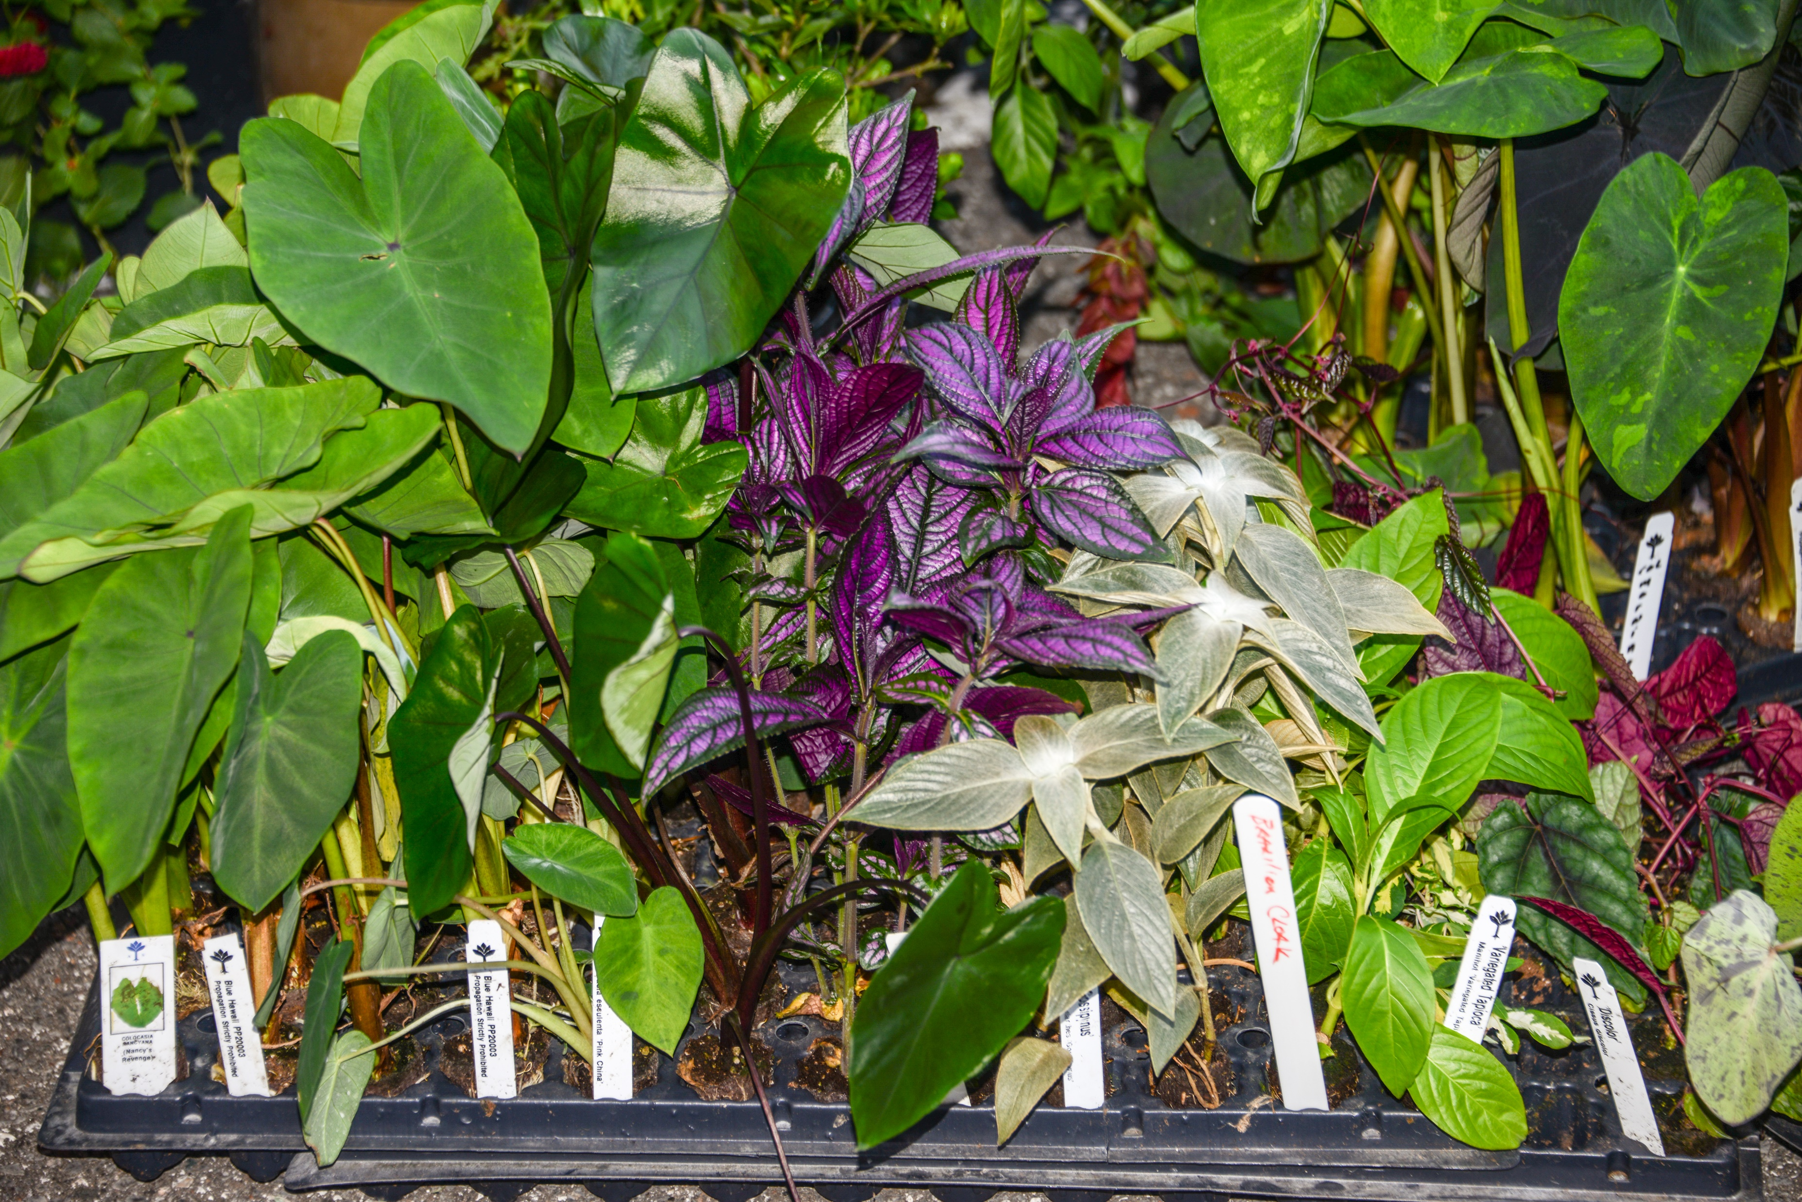
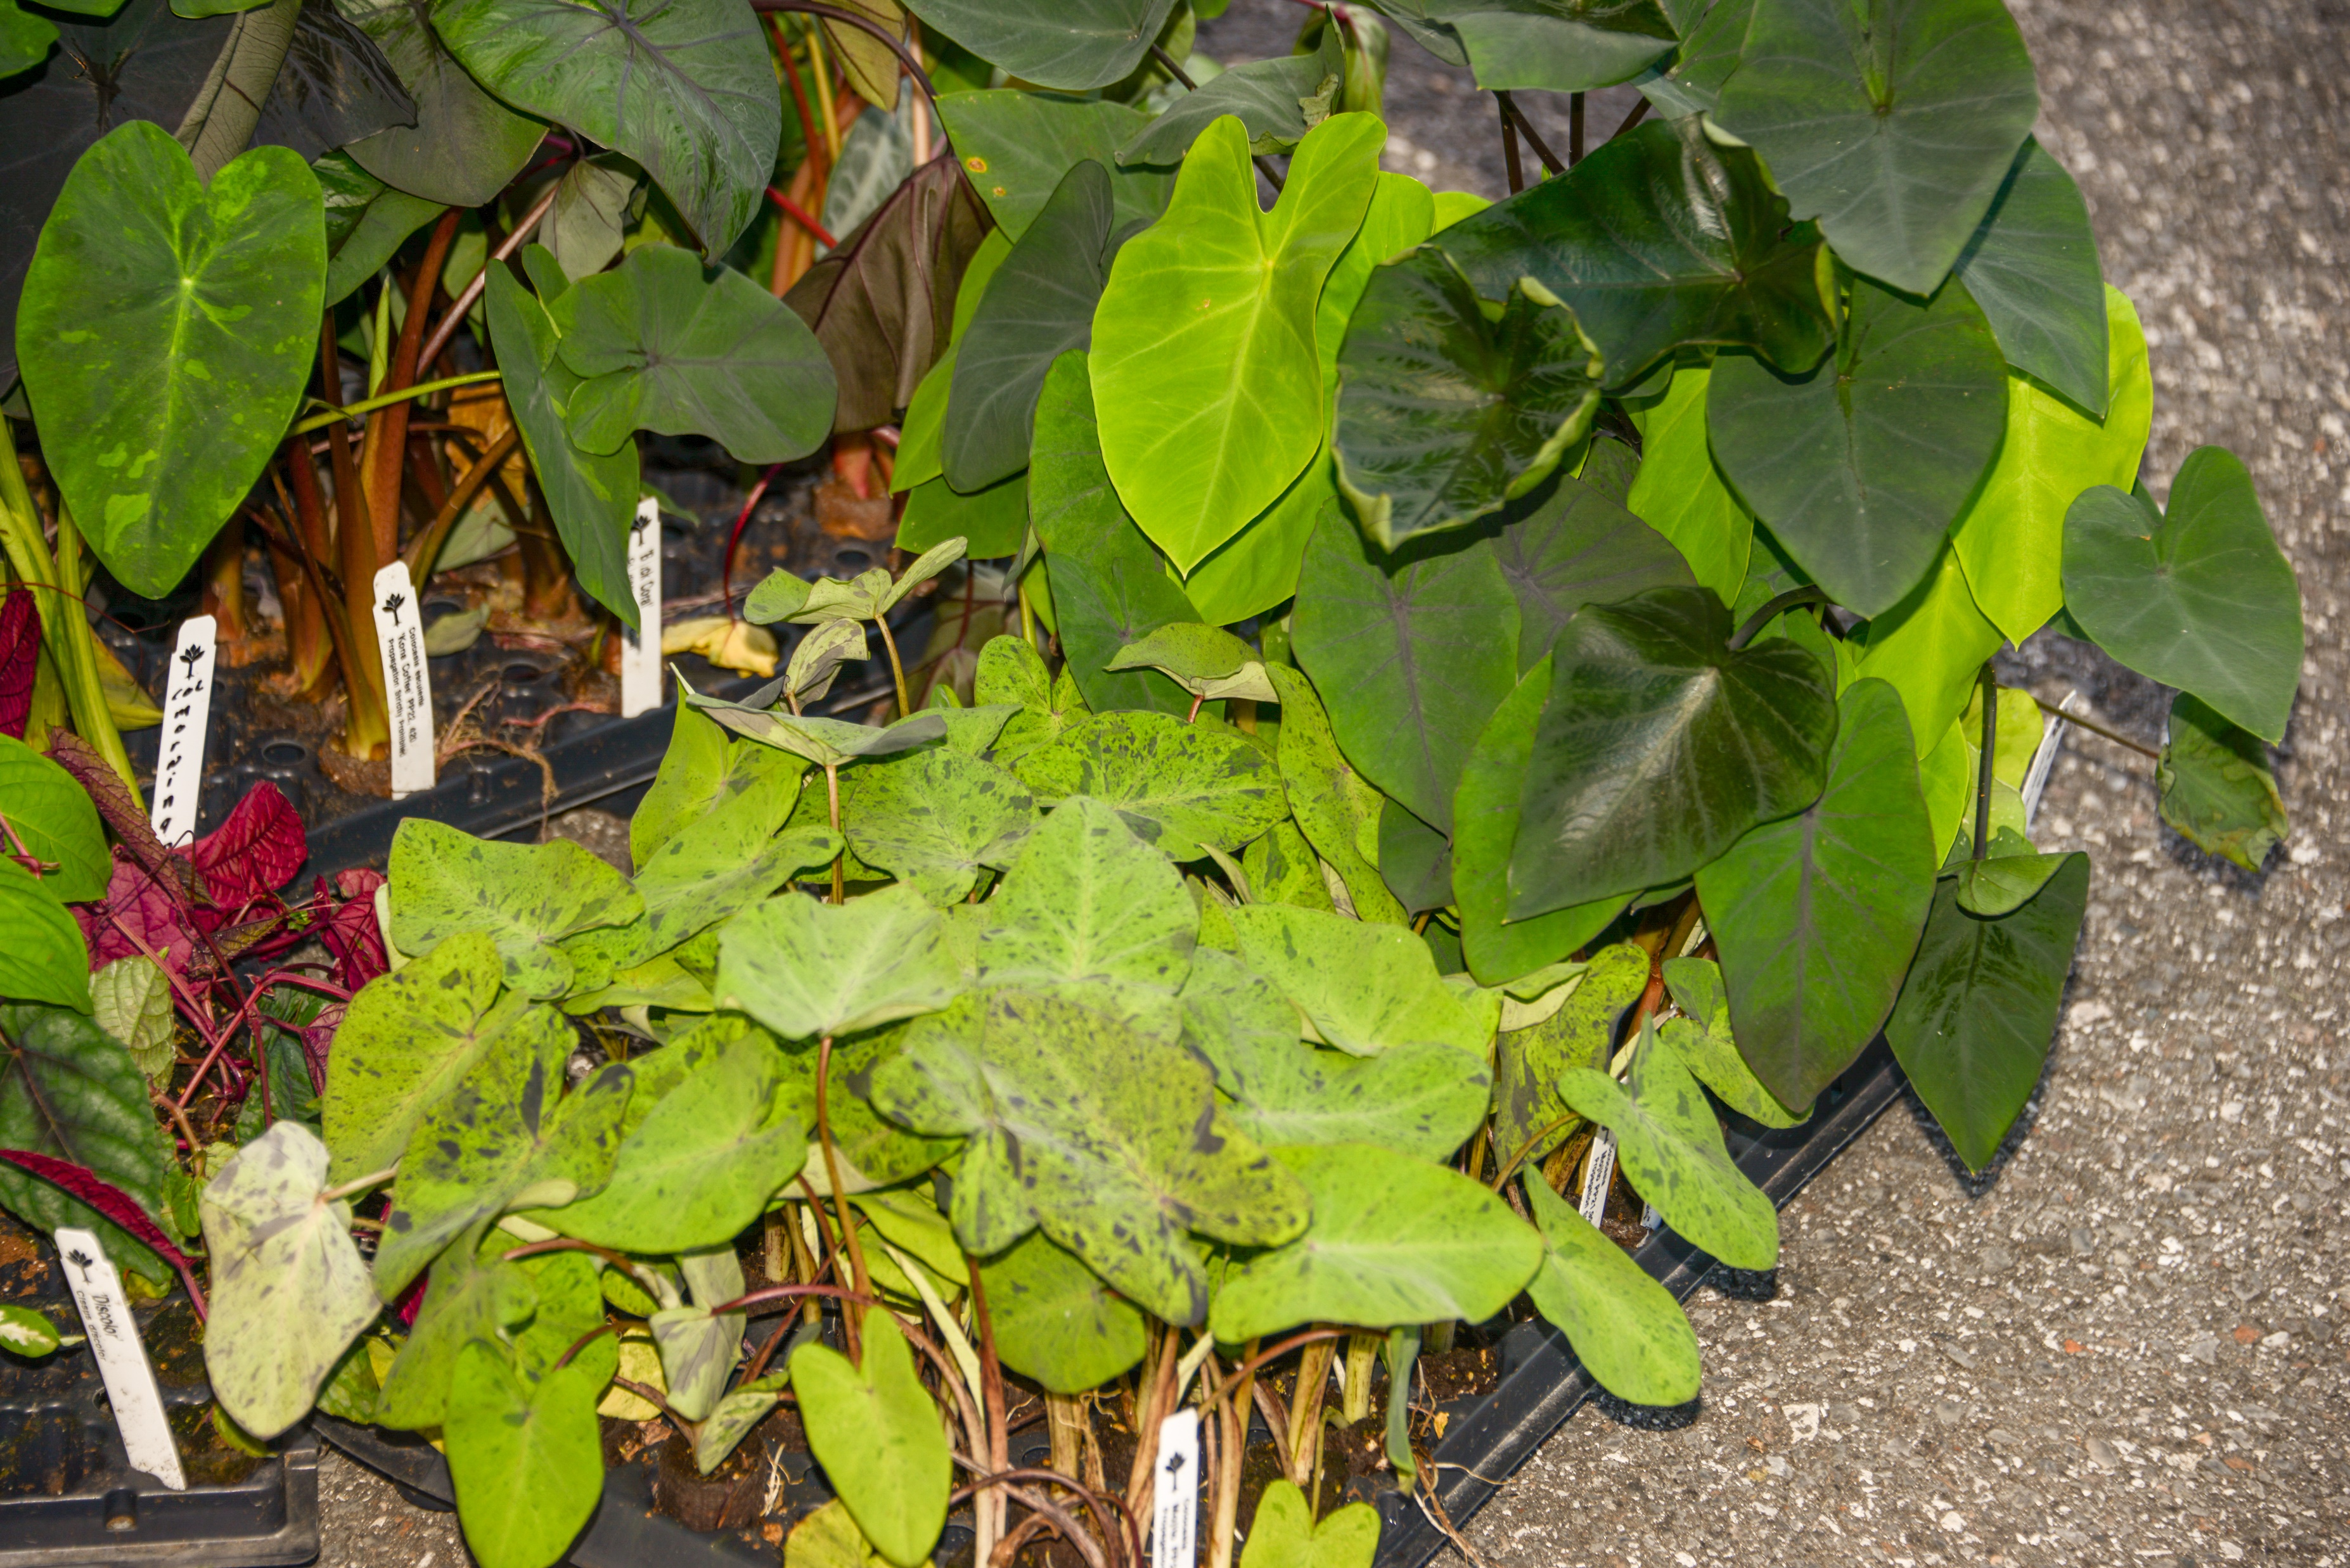

Slide 10
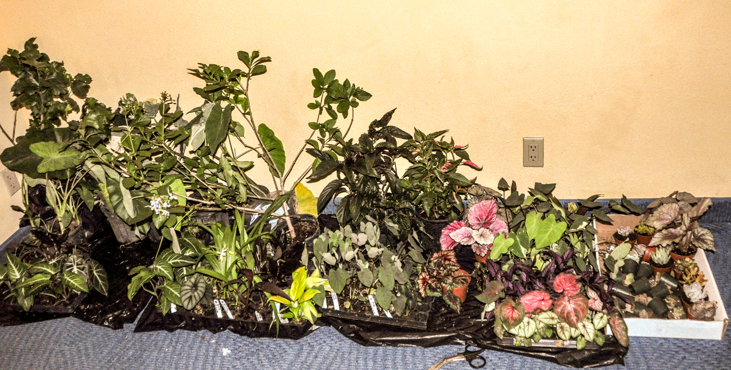

Slide 11
You’re tired
You’re hungry
There’s a party going on
Here’s what you’ll look like if you don’t pack carefully

Slide 12
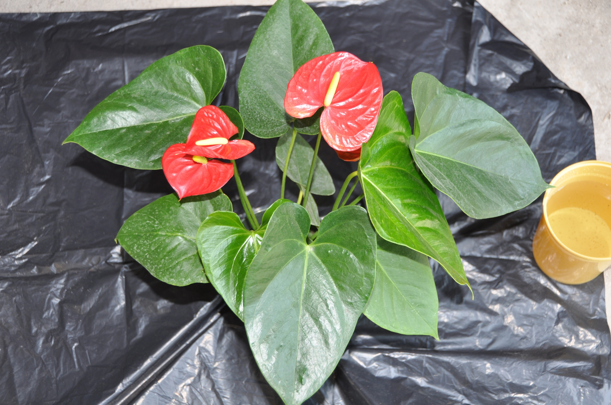
Get it home without damage

Slide 13
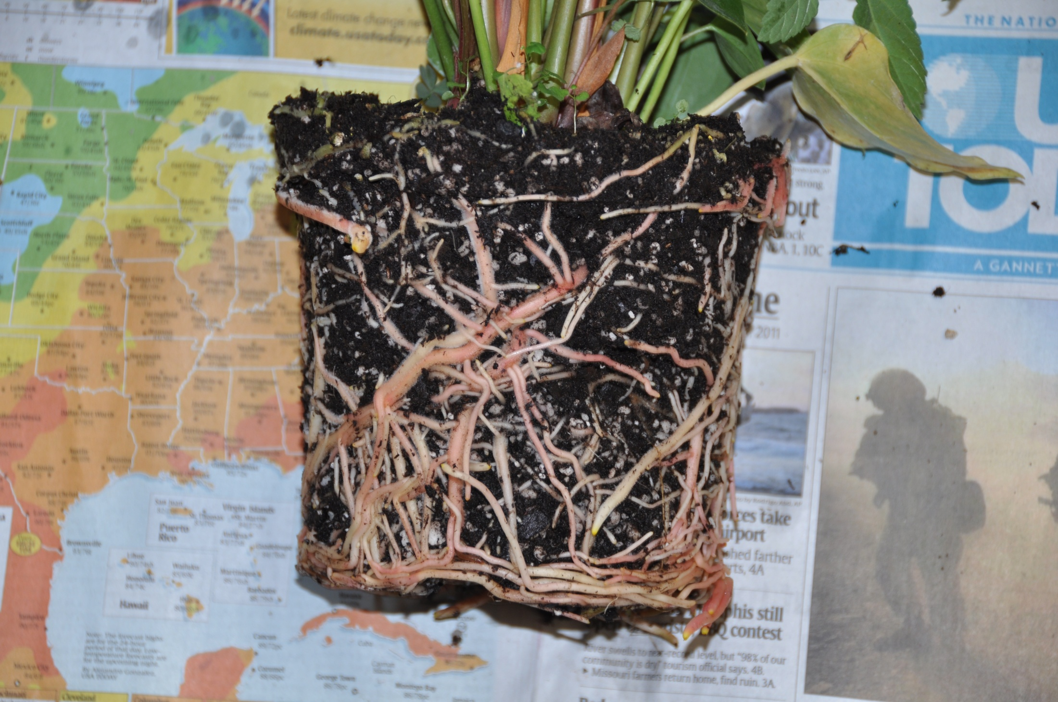
I wanted the plant. I can supply my own soil

Slide 14
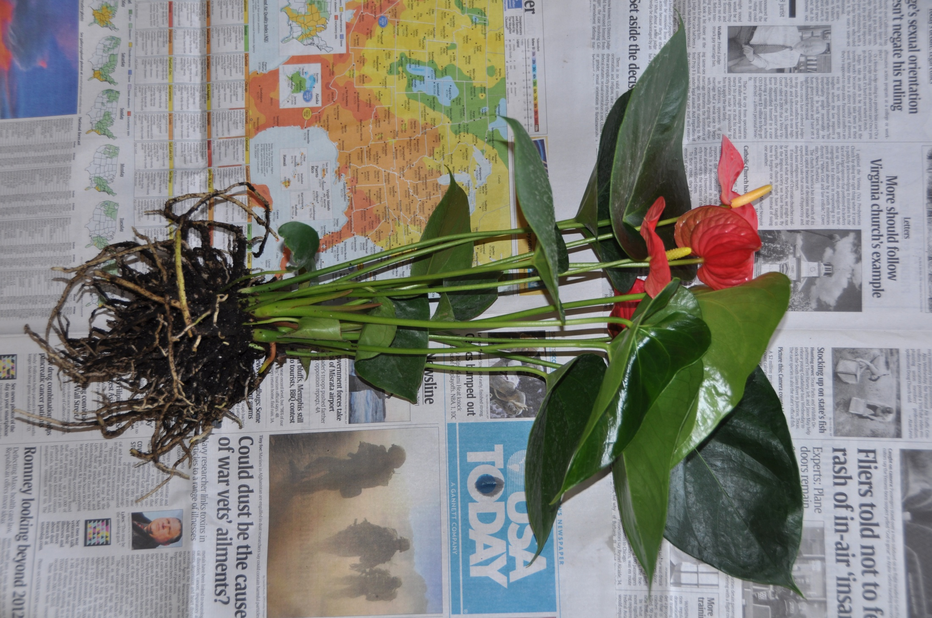
Step one – shake off the soil

Slide 15
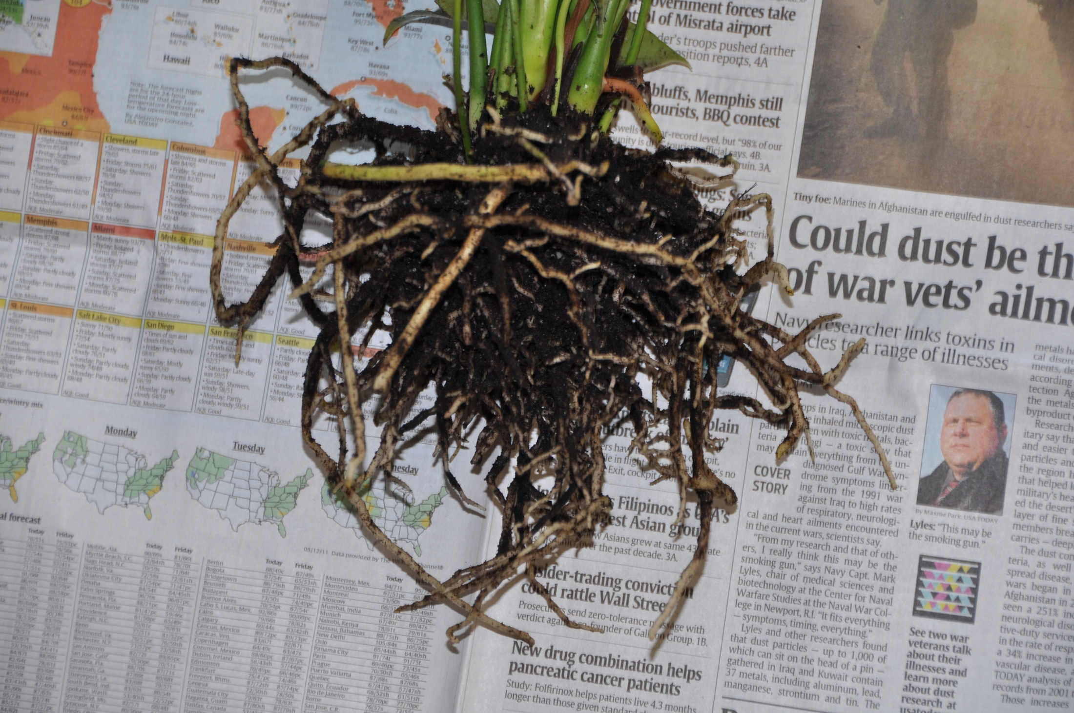
The finer the roots, the more soil you need to leave undisturbed
Note: soil remains on these roots. Enough has been removed for easy packing, travel & repotting within the US. If importing from another country, all traces of soil must be washed off to assure acceptance by the airport inspection station.

Slide 16
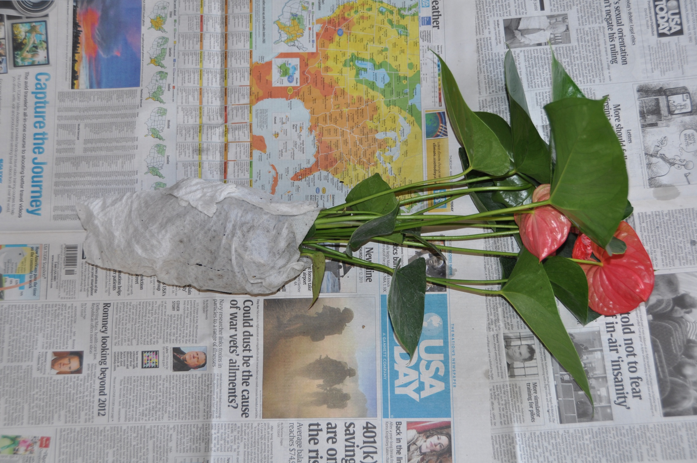
Wrap the root mass in a moist paper towel

Slide 17
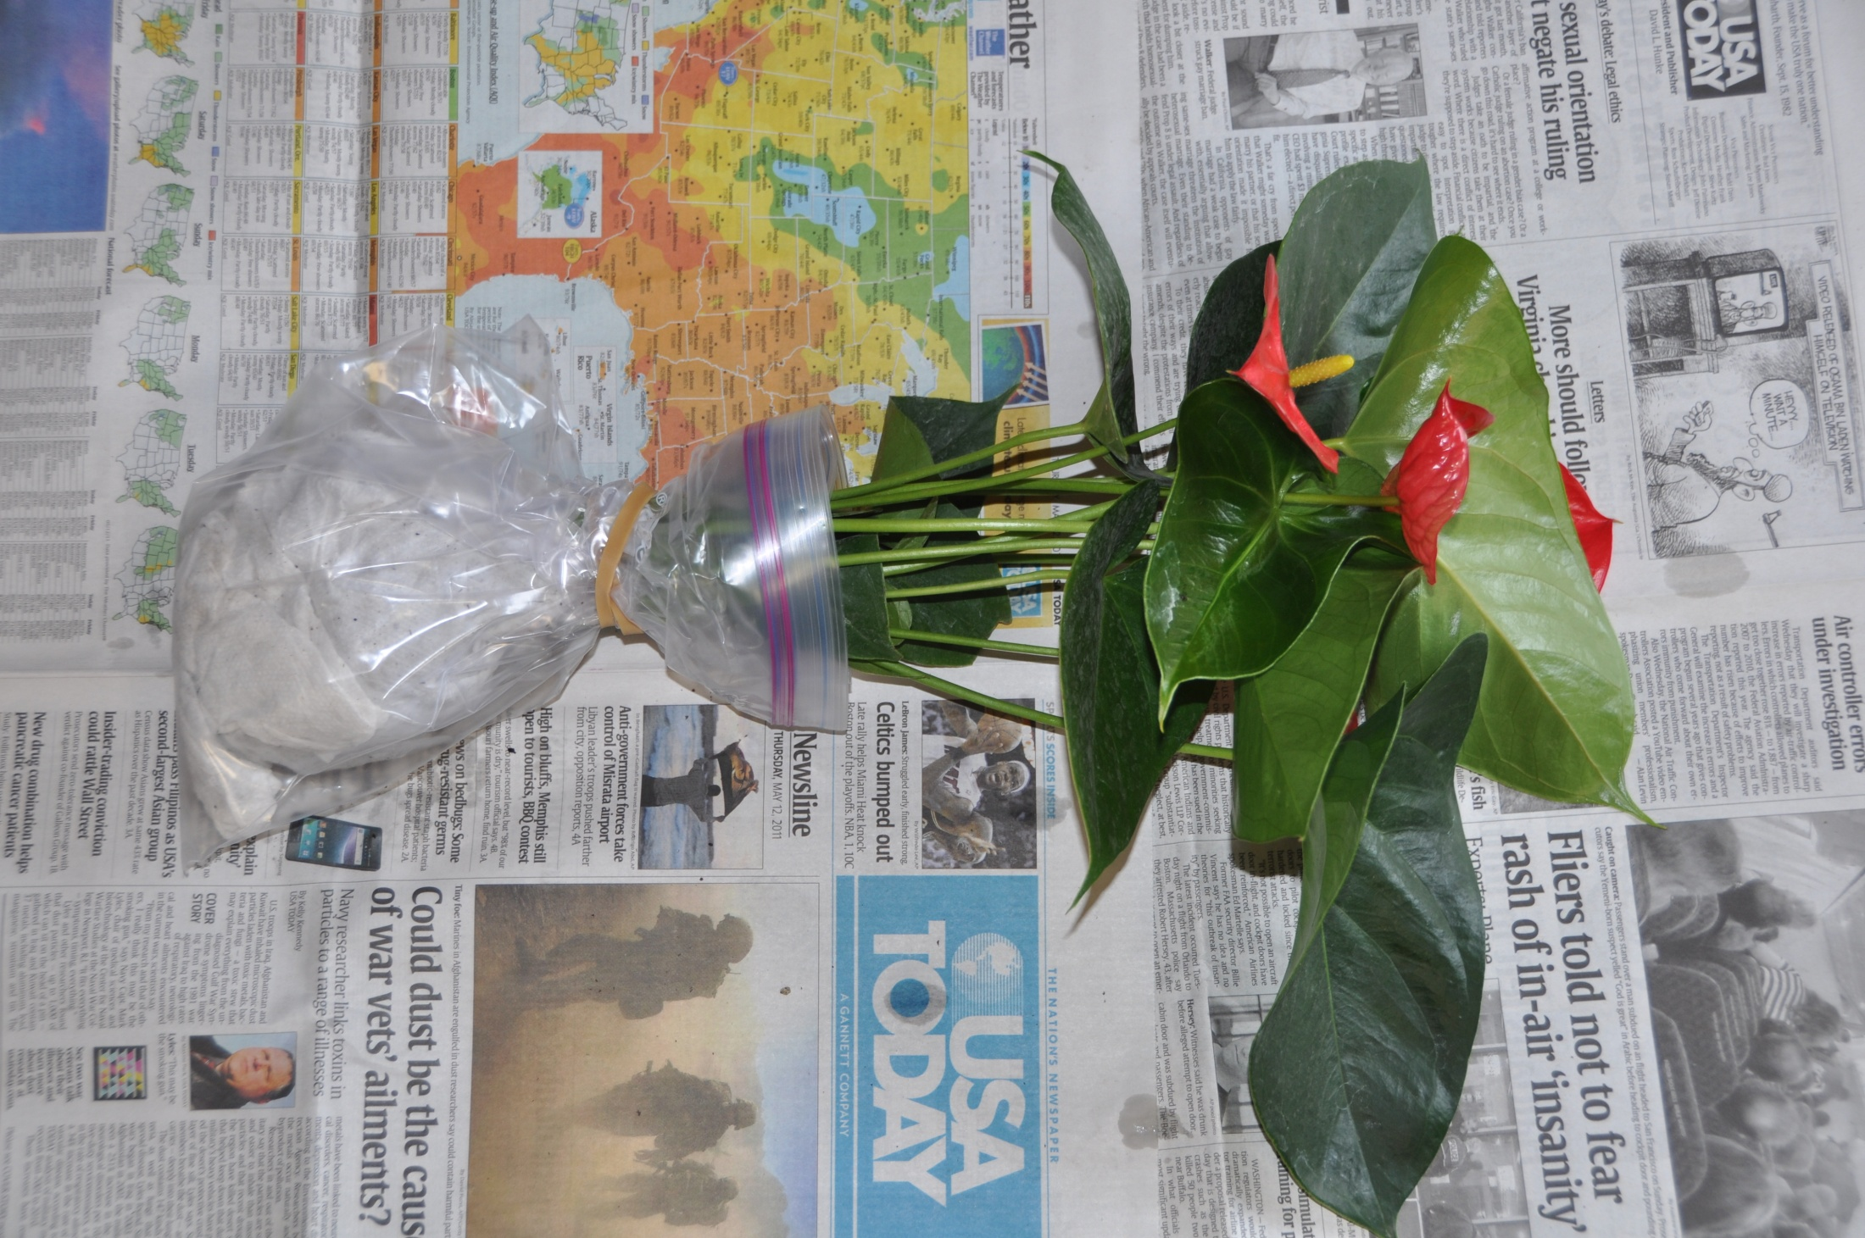
Surround the root mass & paper towel with a plastic bag, secure with rubber band.

Slide 18
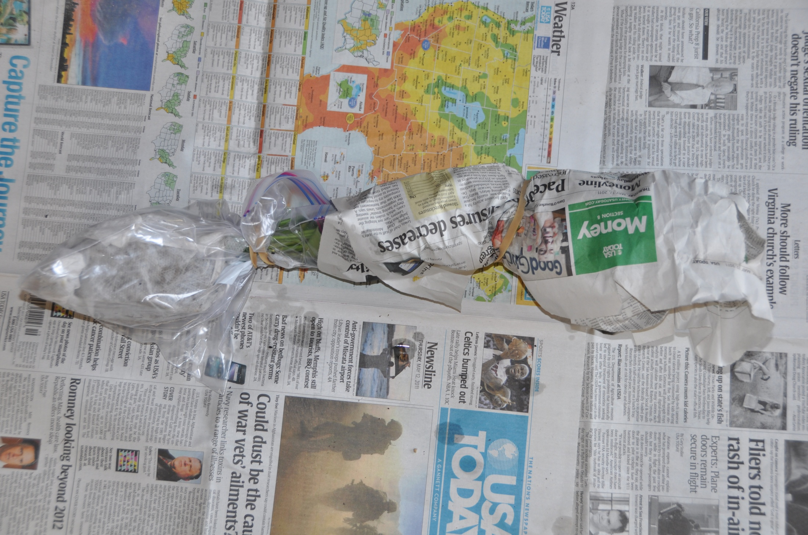
Wrap the top in newspaper or a packing sleeve

Slide 19
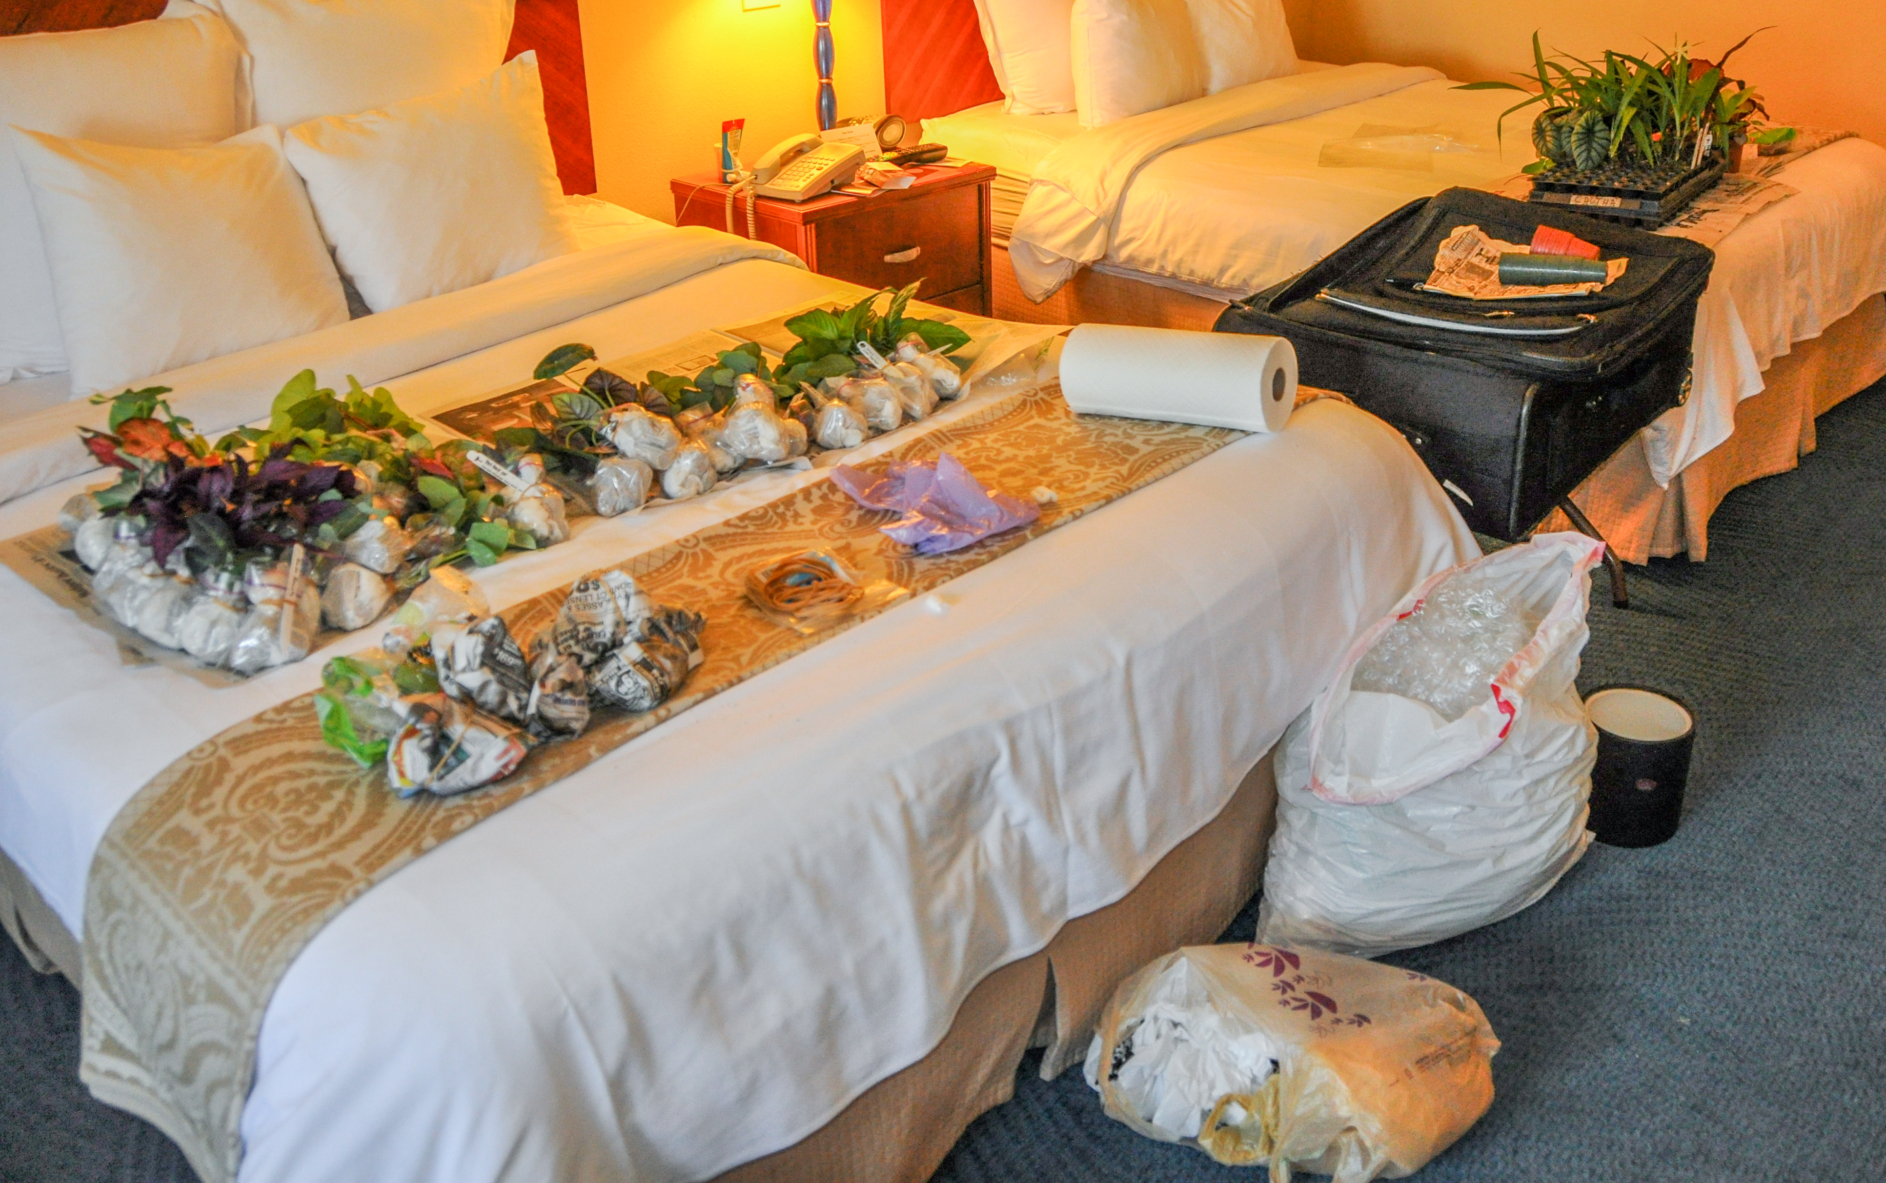

Slide 20
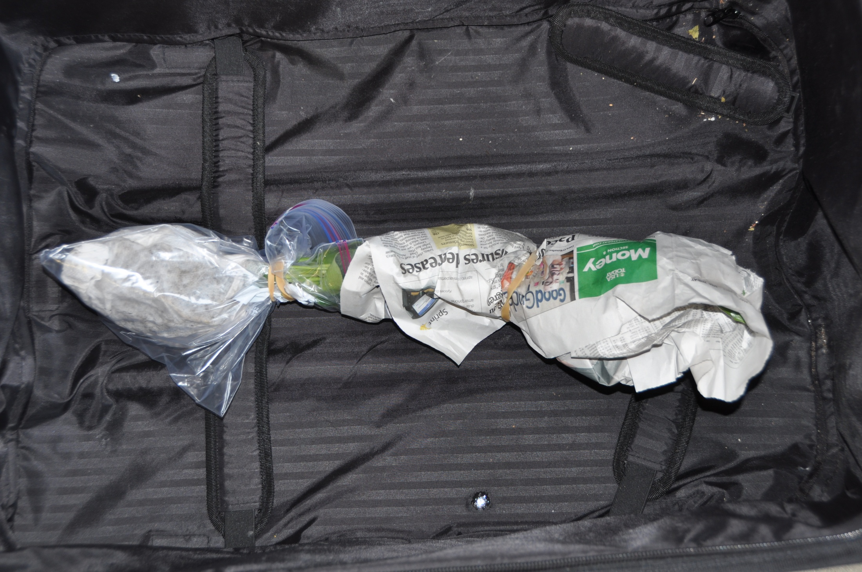
Here’s that plant in my empty suitcase

Slide 21
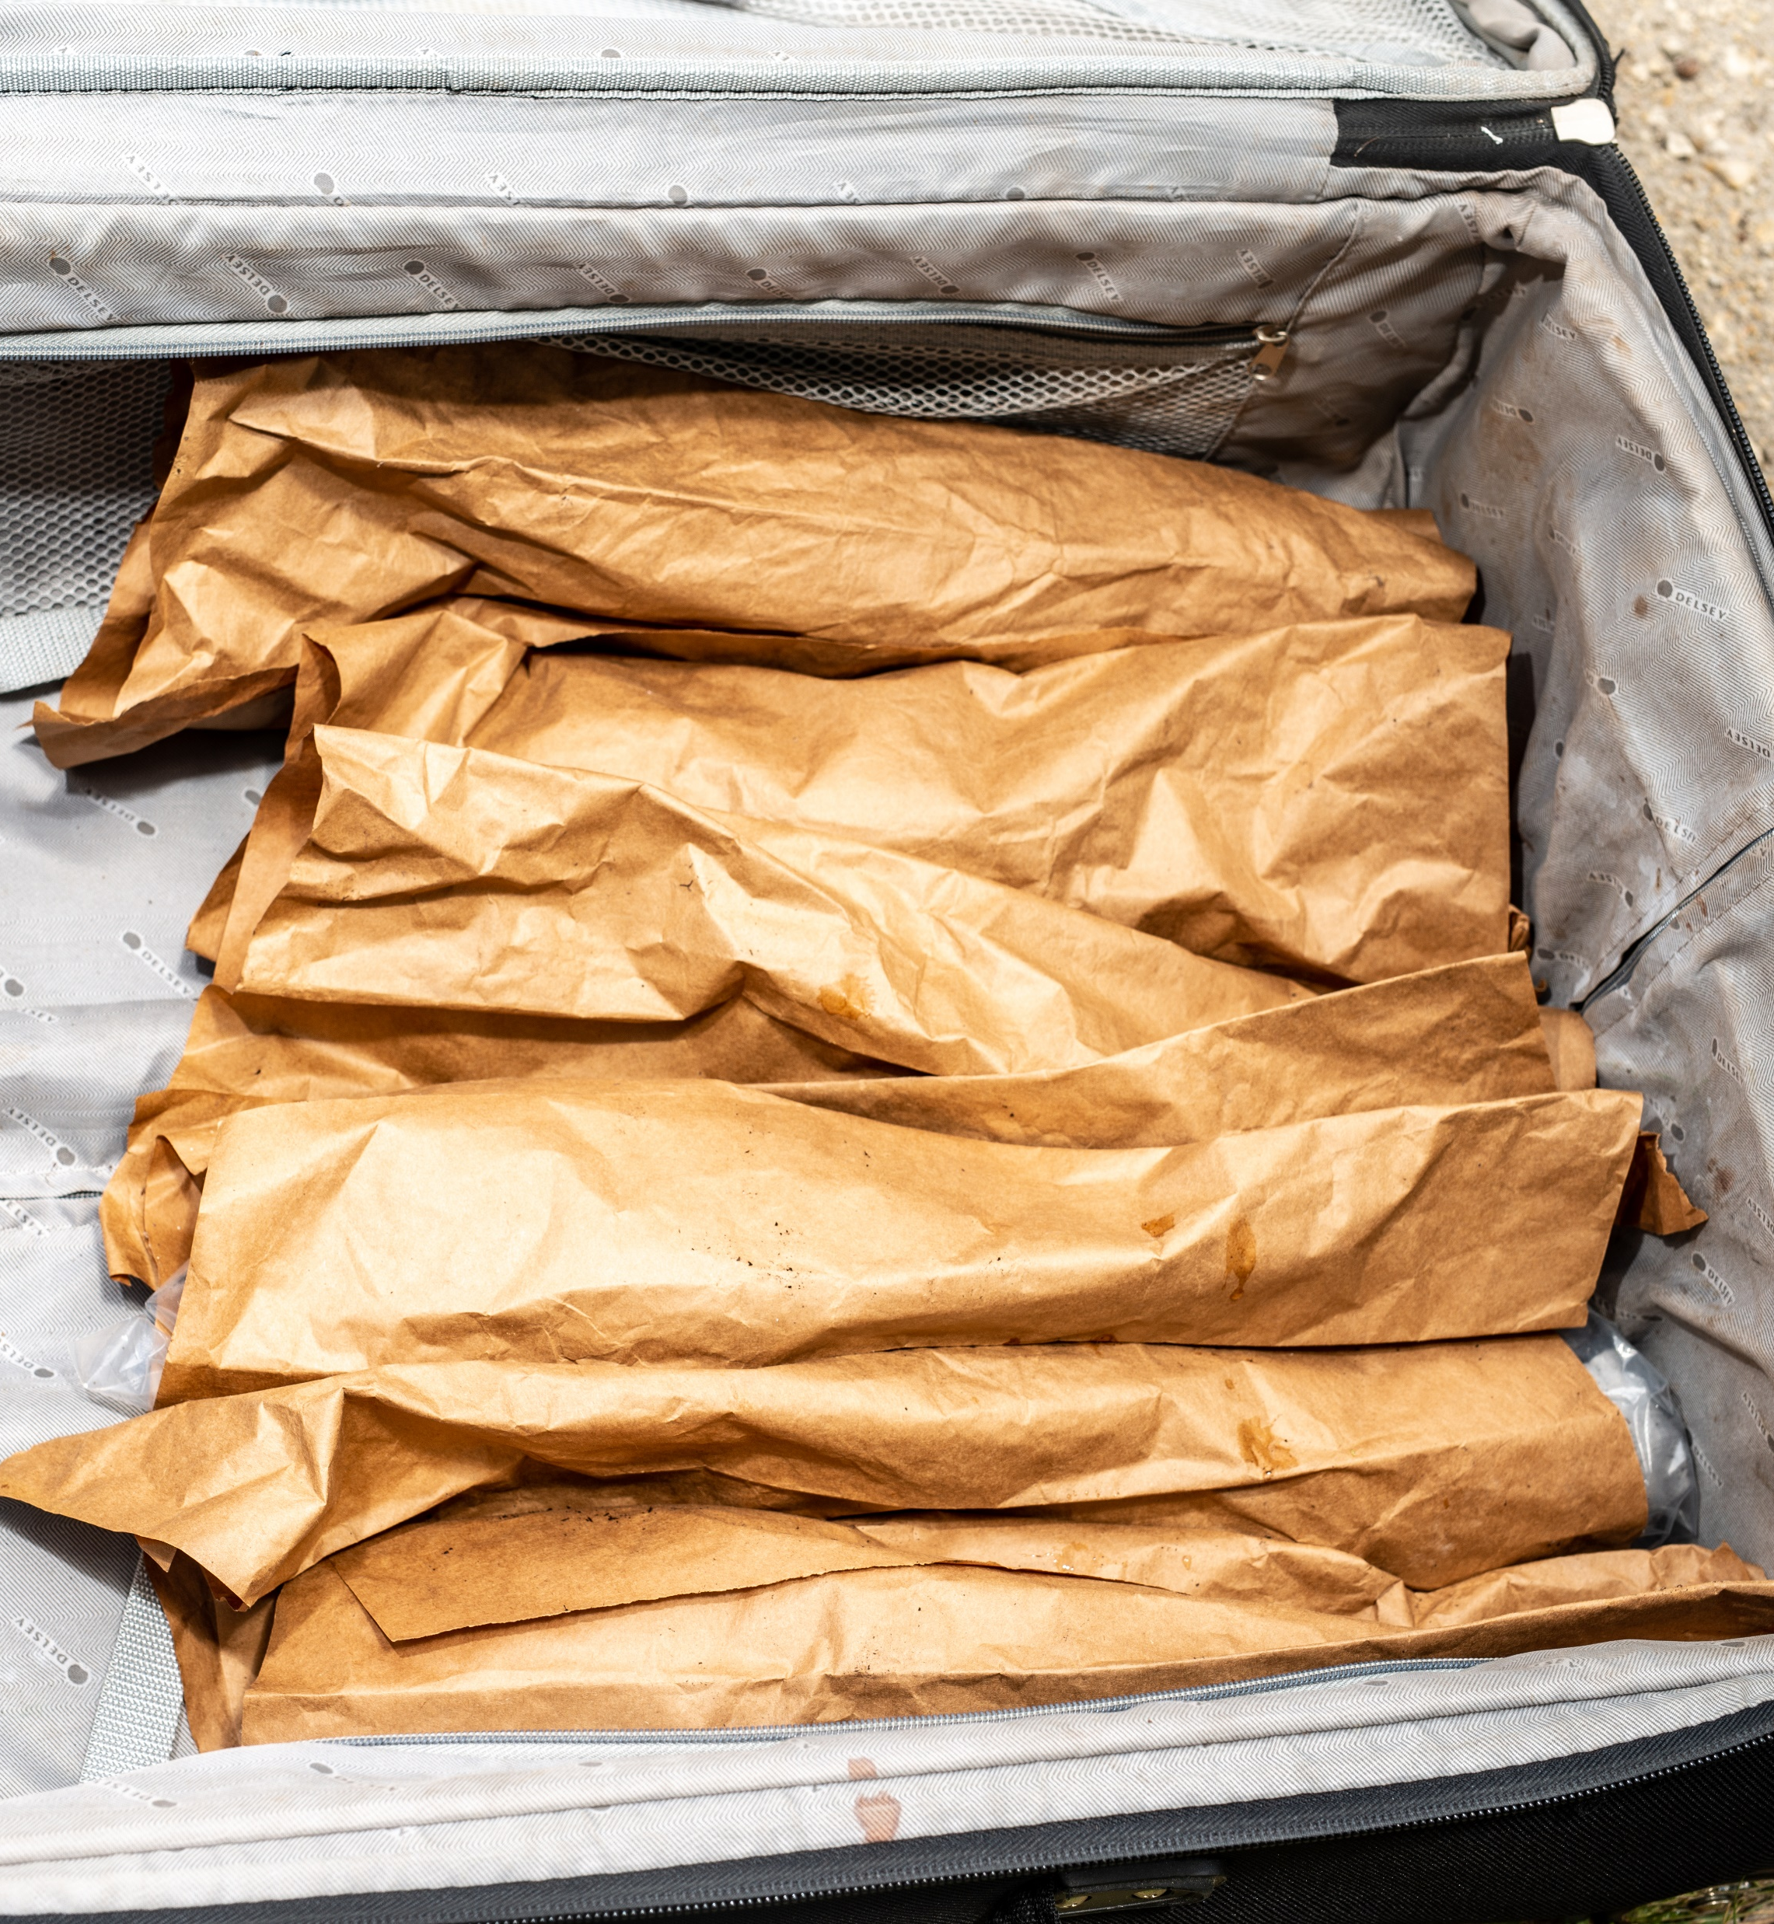

Slide 22
Packing list
Rubber bands
Plastic bags (yes you can reuse them)
Packing tape
Plastic labels & a marking pen
Packing sleeves or newspaper
Styrofoam packing peanuts.

Slide 23
Plant Import License
Protecting Agriculture and the Environment from Invasive Plant Pests and Diseases: An invasive pest is a non-native species whose introduction into the country can cause damage to the economy, natural resources, or human health.

Slide 24
The next step: apply for a plant import license – find it on the web

Slide 25
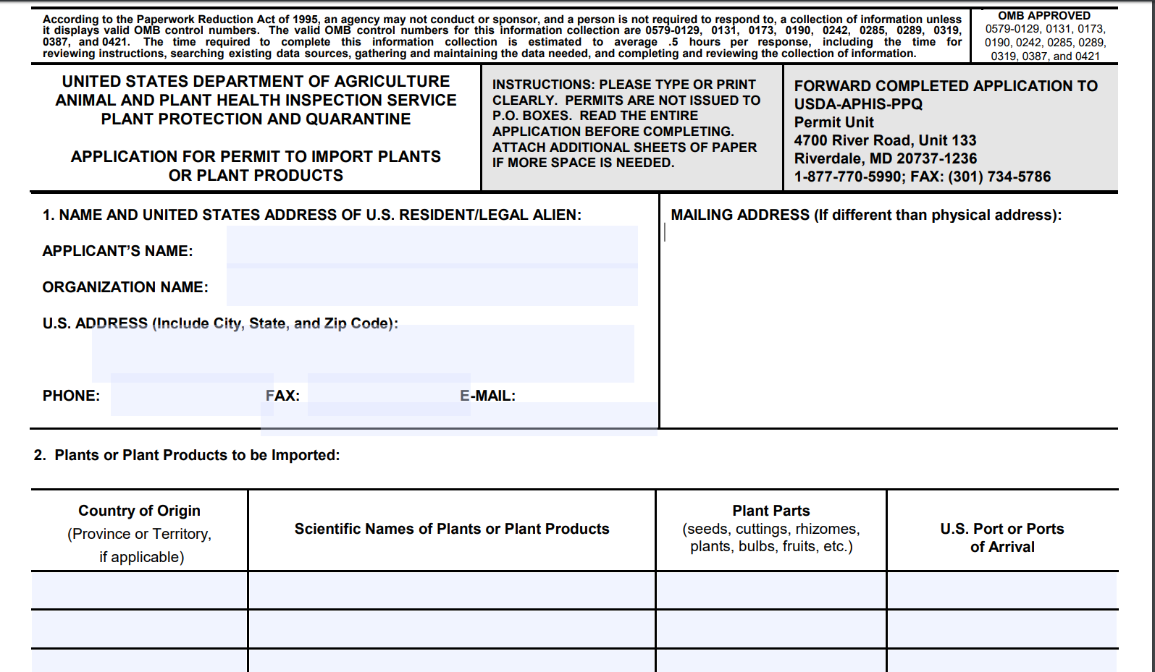
https://www.aphis.usda.gov/library/forms/pdf/PPQ587.pdf

Slide 26
Import Requirements
Plant import license
Plant must be acceptable for import
List available at that application website
Accurately labeled
Phytosanitary certificate from the country of origin
Submit for inspection upon airport arrival

Slide 27
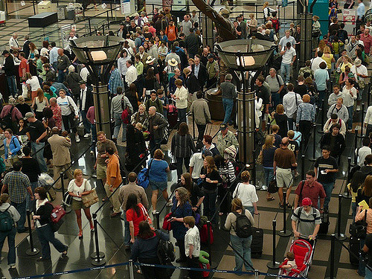
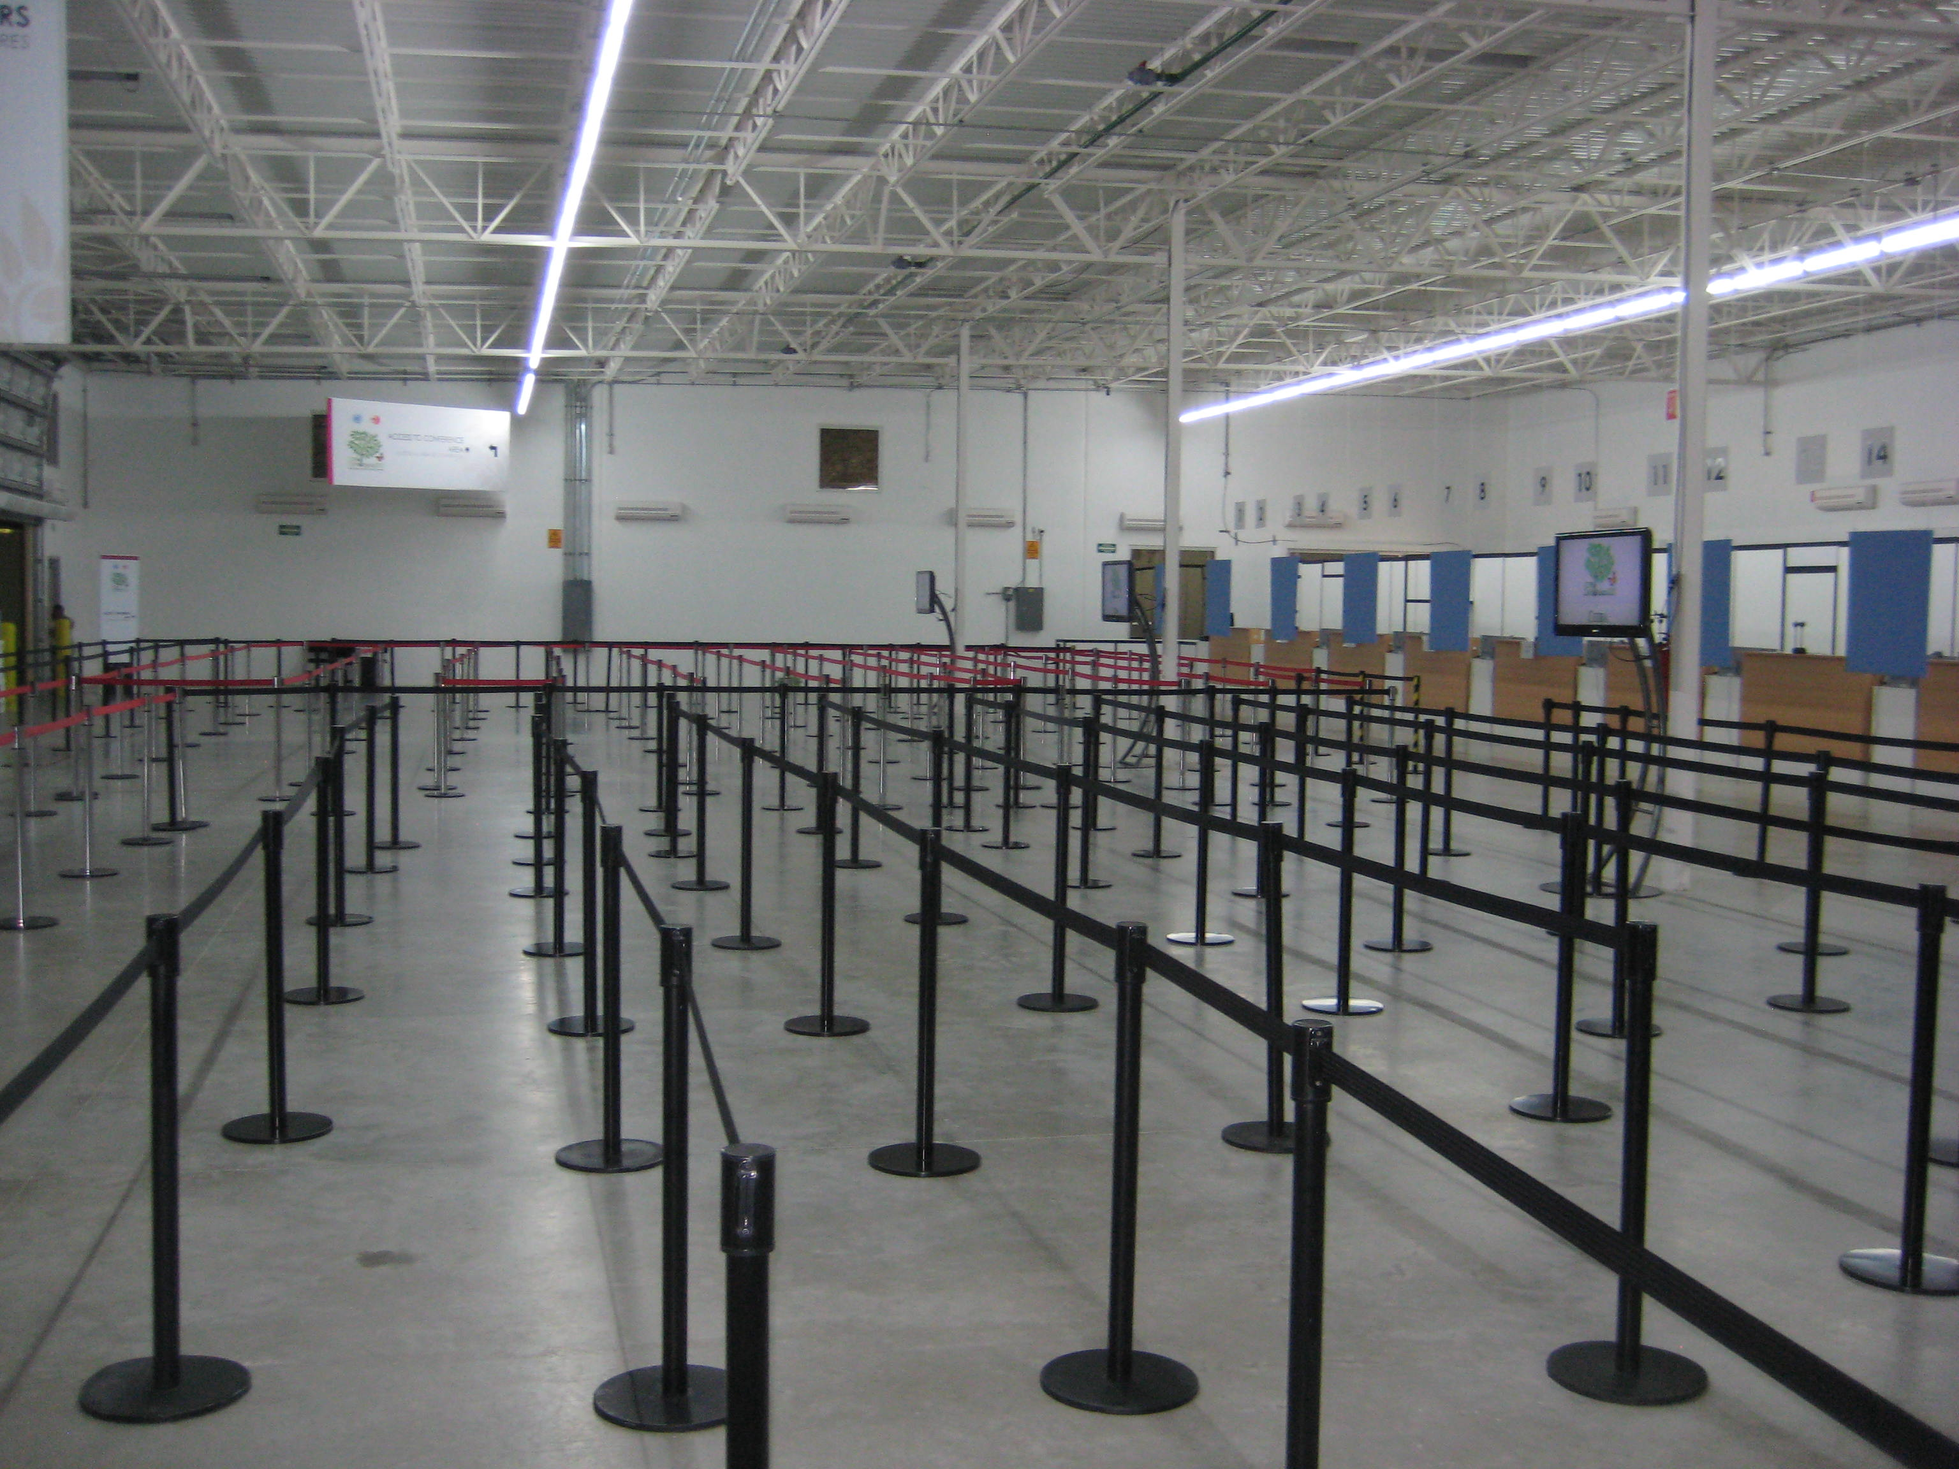
Upon arrival at customs, signs direct you to one of two lines:
Travelers without plant or animal products
Travelers with plant or animal products

Slide 28
Here’s what I did wrong in 2004:
Arrived on Friday evening of a holiday weekend
Arrived in a northern airport (JFK) in February
Here’s what you should do right:
Arrive early in the week – Monday if possible
If it’s winter, and you live in the north, arrive in a southern airport
Plan time in that town for the plants to get through customs

